Slide 1


INPA multi-site study of neurobehavioural disability
Which measures should we use?
Sara D S Ramos
Research Fellow
Reducing the Burden of Neurobehavioural Disability after Acquired Brain Injury: Past, Present and Future
Swansea 28 November 2016

Slide 2
What are we measuring?
Outcomes
Inputs
Neurobehavioural disability

Slide 3

Track progress
Ethical practice
Determine treatment need
Determine overall functioning
Benchmarking
Research
Marketing
Inform plan of care
Enhance communication
Required by stakeholder
Notes:
Image credit: https://huntingenglish.wordpress.com/2013/06/25/question-time-and-asking-why/

Slide 4
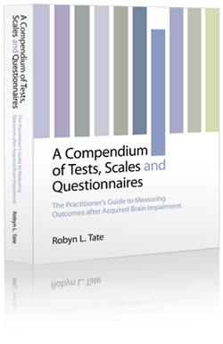

Which ones could be used?
746 pages
http://www.tbims.org/combi/
http://www.rehabmeasures.org/
Notes:
Image credits: http://sydney.edu.au/medicine/people/academics/profiles/robyn.tate.php; http://www.compendium-of-scales.com/

Slide 5
Which ones are being used?
Inpatient rehabilitation
Cognitive and behavioural units
Category | Examples
Motor function Mobility Upper limb Global disability EADLs General Health | Motricity index 10’ walk 9-hole peg test Modified Barthel Index Original Barthel Index FIM FIM+FAM Nottingham EADL General Health Questionnaire
Category | Examples
Global Behavioural Agitation and aggression Psychosocial outcome Vocational independence | Glasgow Outcome Scale FIM+FAM Neurobehavioural Rating Scale Neuropsychiatric Inventory Health of the Nation Outcome Scale Overt Aggression Scale MPAI-4
Pender & Fleminger (1999) Neuropsychological Rehabilitation, 9 (3/4)
Turner-Stokes (1999) Neuropsychological Rehabilitation, 9 (3/4)
Turner-Stokes & Turner-Stokes (1997) Clinical Rehabilitation, 11

Slide 6
What?
• Symptoms
• Disability
• Intervention target
Why?
• To measure outcome
• To show change
• To measure clinical input
How?
…

Slide 7
The INPA multi-site study of neurobehavioural disability

Slide 8


Cognitive
Behavioural
The term that has grown in use to denote this complex, subtle, yet pervasive constellation of cognitive-behaviour changes is ‘neurobehavioural disability’.
- Wood (2001), p. 4
Emotional
Personality changes
Poor social judgement
Labile mood
Poor impulse control
Poor insight
Executive dysfunction
Attention deficits

Slide 9
The INPA multi-site study of neurobehavioural disability
14 services
299 admissions
6 measures

Slide 10
The INPA multi-site study of neurobehavioural disability
Measures
HoNOS-ABI
Health of the Nation Outcome Scale
FIM+FAM
Functional Independence + Functional Assessment Measure
SASNOS
Saint Andrews-Swansea Neurobehavioural Outcomes Scale
MPAI-4
Mayo Portland Adaptability Inventory (version 4)
SRS
Supervision Rating Scale
RCS-E
Rehabilitation Complexity Scale-Extended

Slide 11
The INPA multi-site study of neurobehavioural disability
Method
Ratings collected at two time points for the all measures…
… Except RCS-E (gathered fortnightly)
Raw scores converted into t-scores when available
Sub-scale scores used for FIM+FAM, MPAI-4, SASNOS and RCS-E

Slide 12
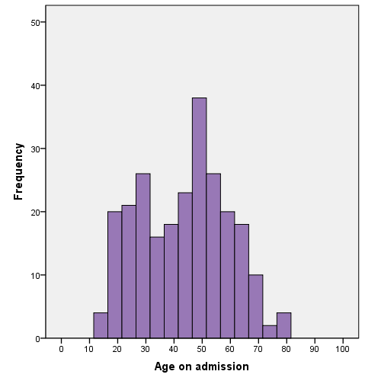
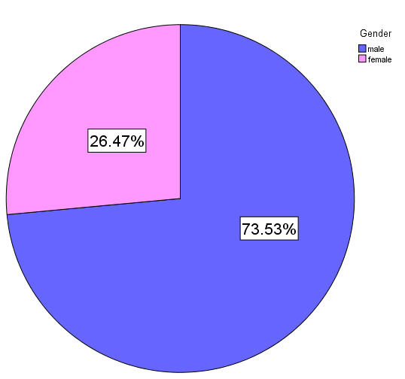
The INPA multi-site study of neurobehavioural disability
Results
The INPA multi-site study of neurobehavioural disability
Age and gender
M = 43.54, SD = 15.59

Slide 13
Diagnosis | N | Valid %
TBI | 115 | 46.2
CVA | 51 | 20.5
Infarct | 13 | 5.2
Haemorrhagic stroke | 14 | 5.6
Sub-arachnoid haemorrhage | 5 | 1.8
Other stroke | 19 | 7.0
Anoxia | 28 | 11.2
Inflammatory | 19 | 7.6
Intoxication | 8 | 3.2
Tumour | 2 | 0.7
Other | 26 | 10.4
(Missing) | (23) | (8.8)

Slide 14
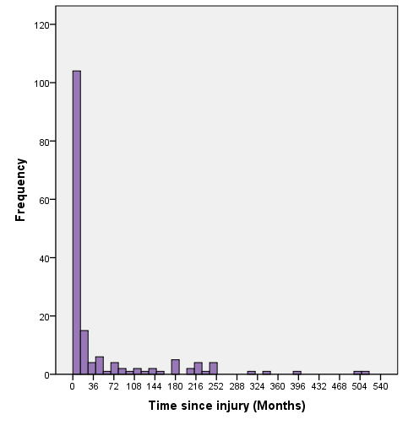
The INPA multi-site study of neurobehavioural disability
Time Since Injury
Median = 8 months
M = 49.02 SD = 92.69
30% within 3 months
62% within 12 months
71% within 24 months

Slide 15
The INPA multi-site study of neurobehavioural disability
Total Scores on Admission
Measure (Reference) | Mean (SD) | Median
HoNOS (36-48) | 16.97 (6.99) | 16
FIM+FAM (30-150) | 122.39 (46.95) | 134
SASNOS (30-40) | 37.41 (12.96) | 38
MPAI-4 (50-60) | 51.82 (8.98) | 53
SRS (4-13) | - | 8
RCS-E (≥ 10) | 11.93 (3.98) | 12

Slide 18
 | 1 | 2 | 3 | 4 | 5 | 6 | 7 | 8 | 9 | 10 | 11 | 12 | 13 | 14 | 15 | 16 | 17 | 18 | 19
1. FIM+FAM Motor | -
2. FIM+FAM Cognitive |  | -
3. FIM+FAM EADL |  |  | -
4. SASNOS Interpersonal |  |  |  | -
5. SASNOS Cognition |  |  |  |  | -
6. SASNOS Inhibition |  |  |  |  |  | -
7. SASNOS Aggression |  |  |  |  |  |  | -
8. SASNOS Communication |  |  |  |  |  |  |  | -
9. MPAI-4 Ability |  |  |  |  |  |  |  |  | -
10. MPAI-4 Adjustment |  |  |  |  |  |  |  |  |  | -
11. MPAI-4 Participation |  |  |  |  |  |  |  |  |  |  | -
12. HONOS-ABI |  |  |  |  |  |  |  |  |  |  |  | -
13. SRS |  |  |  |  |  |  |  |  |  |  |  |  | -
14. RCS Care |  |  |  |  |  |  |  |  |  |  |  |  |  | -
15. RCS Risk |  |  |  |  |  |  |  |  |  |  |  |  |  |  | -
16. RCS Nursing |  |  |  |  |  |  |  |  |  |  |  |  |  |  |  | -
17. RCS Medical |  |  |  |  |  |  |  |  |  |  |  |  |  |  |  |  | -
18. RCS Therapy Disciplines |  |  |  |  |  |  |  |  |  |  |  |  |  |  |  |  |  | -
19. RCS Therapy Intensity |  |  |  |  |  |  |  |  |  |  |  |  |  |  |  |  |  |  | -
20. RCS Equipment
Making sense of a puzzle…

Slide 19
 | 1 | 2 | 3 | 4 | 5 | 6 | 7 | 8 | 9 | 10 | 11 | 12 | 13 | 14 | 15 | 16 | 17 | 18 | 19
1. FIM+FAM Motor | -
2. FIM+FAM Cognitive |  | -
3. FIM+FAM EADL |  |  | -
4. SASNOS Interpersonal |  |  |  | -
5. SASNOS Cognition |  |  |  |  | -
6. SASNOS Inhibition |  |  |  |  |  | -
7. SASNOS Aggression |  |  |  |  |  |  | -
8. SASNOS Communication |  |  |  |  |  |  |  | -
9. MPAI-4 Ability |  |  |  |  |  |  |  |  | -
10. MPAI-4 Adjustment |  |  |  |  |  |  |  |  |  | -
11. MPAI-4 Participation |  |  |  |  |  |  |  |  |  |  | -
12. HONOS-ABI |  |  |  |  |  |  |  |  |  |  |  | -
13. SRS |  |  |  |  |  |  |  |  |  |  |  |  | -
14. RCS Care |  |  |  |  |  |  |  |  |  |  |  |  |  | -
15. RCS Risk |  |  |  |  |  |  |  |  |  |  |  |  |  |  | -
16. RCS Nursing |  |  |  |  |  |  |  |  |  |  |  |  |  |  |  | -
17. RCS Medical |  |  |  |  |  |  |  |  |  |  |  |  |  |  |  |  | -
18. RCS Therapy Disciplines |  |  |  |  |  |  |  |  |  |  |  |  |  |  |  |  |  | -
19. RCS Therapy Intensity |  |  |  |  |  |  |  |  |  |  |  |  |  |  |  |  |  |  | -
20. RCS Equipment
Some overlap for areas of impairment

Slide 20
 | 1 | 2 | 3 | 4 | 5 | 6 | 7 | 8 | 9 | 10 | 11 | 12 | 13 | 14 | 15 | 16 | 17 | 18 | 19
1. FIM+FAM Motor | -
2. FIM+FAM Cognitive |  | -
3. FIM+FAM EADL |  |  | -
4. SASNOS Interpersonal |  |  |  | -
5. SASNOS Cognition |  |  |  |  | -
6. SASNOS Inhibition |  |  |  |  |  | -
7. SASNOS Aggression |  |  |  |  |  |  | -
8. SASNOS Communication |  |  |  |  |  |  |  | -
9. MPAI-4 Ability |  |  |  |  |  |  |  |  | -
10. MPAI-4 Adjustment |  |  |  |  |  |  |  |  |  | -
11. MPAI-4 Participation |  |  |  |  |  |  |  |  |  |  | -
12. HONOS-ABI |  |  |  |  |  |  |  |  |  |  |  | -
13. SRS |  |  |  |  |  |  |  |  |  |  |  |  | -
14. RCS Care |  |  |  |  |  |  |  |  |  |  |  |  |  | -
15. RCS Risk |  |  |  |  |  |  |  |  |  |  |  |  |  |  | -
16. RCS Nursing |  |  |  |  |  |  |  |  |  |  |  |  |  |  |  | -
17. RCS Medical |  |  |  |  |  |  |  |  |  |  |  |  |  |  |  |  | -
18. RCS Therapy Disciplines |  |  |  |  |  |  |  |  |  |  |  |  |  |  |  |  |  | -
19. RCS Therapy Intensity |  |  |  |  |  |  |  |  |  |  |  |  |  |  |  |  |  |  | -
20. RCS Equipment
Interpersonal relationships and cognition are associated with everyday function.
Notes:
“It is noteworthy that psychosocial disabilities (such as difficulties in socialization and vocational functions) are more common than physical disabilities (such as problems with mobility or activities of daily living).”

Slide 21
 | 1 | 2 | 3 | 4 | 5 | 6 | 7 | 8 | 9 | 10 | 11 | 12 | 13 | 14 | 15 | 16 | 17 | 18 | 19
1. FIM+FAM Motor | -
2. FIM+FAM Cognitive |  | -
3. FIM+FAM EADL |  |  | -
4. SASNOS Interpersonal |  |  |  | -
5. SASNOS Cognition |  |  |  |  | -
6. SASNOS Inhibition |  |  |  |  |  | -
7. SASNOS Aggression |  |  |  |  |  |  | -
8. SASNOS Communication |  |  |  |  |  |  |  | -
9. MPAI-4 Ability |  |  |  |  |  |  |  |  | -
10. MPAI-4 Adjustment |  |  |  |  |  |  |  |  |  | -
11. MPAI-4 Participation |  |  |  |  |  |  |  |  |  |  | -
12. HONOS-ABI |  |  |  |  |  |  |  |  |  |  |  | -
13. SRS |  |  |  |  |  |  |  |  |  |  |  |  | -
14. RCS Care |  |  |  |  |  |  |  |  |  |  |  |  |  | -
15. RCS Risk |  |  |  |  |  |  |  |  |  |  |  |  |  |  | -
16. RCS Nursing |  |  |  |  |  |  |  |  |  |  |  |  |  |  |  | -
17. RCS Medical |  |  |  |  |  |  |  |  |  |  |  |  |  |  |  |  | -
18. RCS Therapy Disciplines |  |  |  |  |  |  |  |  |  |  |  |  |  |  |  |  |  | -
19. RCS Therapy Intensity |  |  |  |  |  |  |  |  |  |  |  |  |  |  |  |  |  |  | -
20. RCS Equipment
Neurobehavioural disability is associated with supervision needs.

Slide 22
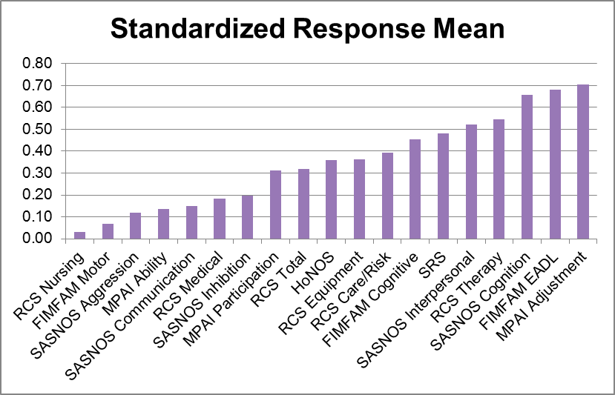
Showing change

Slide 23
So, which measures should we use?
What?
FIM+FAM Cognitive
FIM+ FAM EADL
SASNOS Interpersonal
SASNOS Cognition
MPAI Adjustment
MPAI Participation

Slide 24
So, which measures should we use?
What?
FIM+FAM Cognitive
FIM+ FAM EADL
SASNOS Interpersonal
SASNOS Cognition
MPAI Adjustment
MPAI Participation

Slide 25
Specifically neurobehavioural?
What?
SASNOS Cognition
SASNOS Inhibition
MPAI Adjustment
RCS Risk

Slide 26
So, which measures should we use?
Why?
Clinical Input | Change
RCS Therapy* | MPAI Adjustment
SRS | FIM+FAM EADL*
RCS Care/Risk | SASNOS Cognition
 | SASNOS Interpersonal

Slide 27
So, which measures should we use?
Why?
Clinical Input | Change
RCS Therapy* | MPAI Adjustment
SRS | FIM+FAM EADL*
RCS Care/Risk | SASNOS Cognition
 | SASNOS Interpersonal

Slide 28
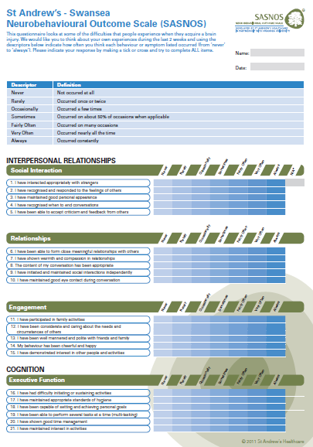
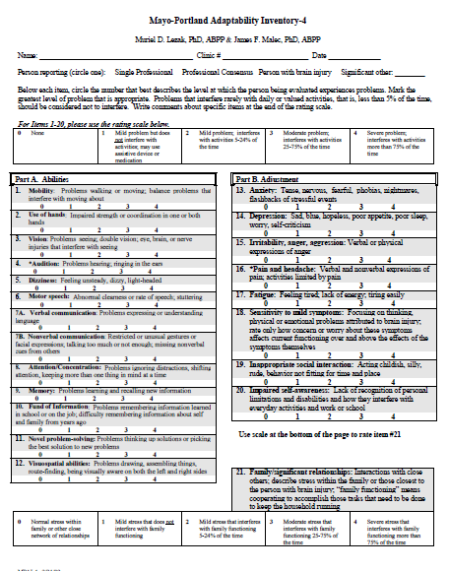
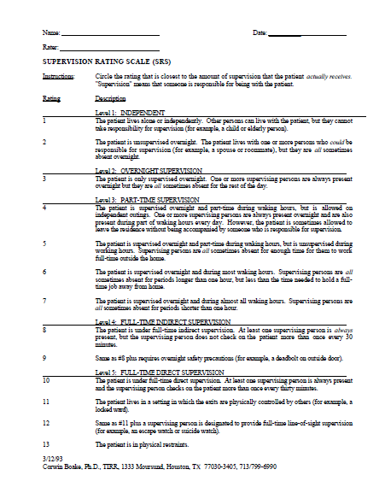

Slide 29
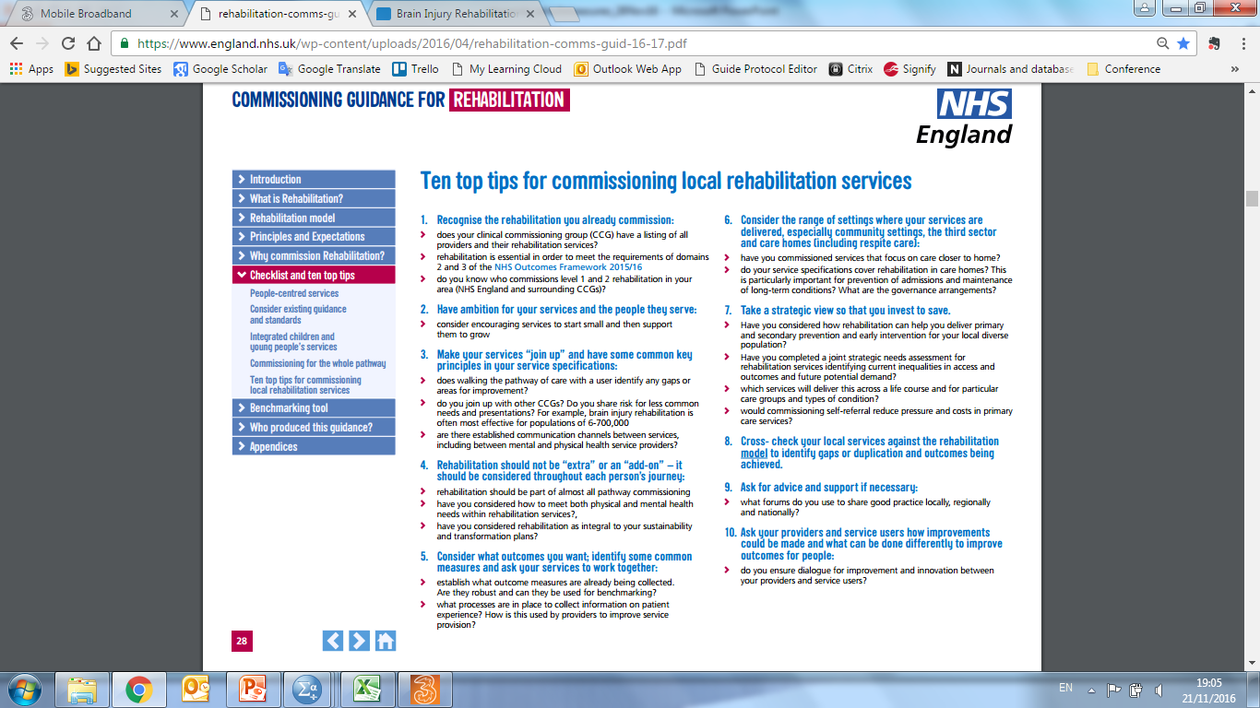

Slide 30
Working group
Nick Alderman
Kristy Bolter
Keith Jenkins
Caroline Knight
Mark Butler
… and others

Slide 31
Thank you!
sara.dasilvaramos@thedtgroup.org

